Slide 1
Android App Market
INTRODUCTION
Process
Insights
Summary

Slide 2
INTRODUCTION
Mobile apps are ubiquitous and have become popular due to their ease of creation and potential for generating income. As a result, there is a growing number of apps being developed. In this notebook, we will conduct a thorough analysis of the Android app market by comparing over ten thousand apps in Google Play across various categories. Our goal is to extract valuable insights from the data in order to develop effective strategies for driving growth and user retention.

Slide 3
PROCESS
Data gathering.
Data cleaning
Data modelling
Data analysis
Uncovering insights

Slide 4
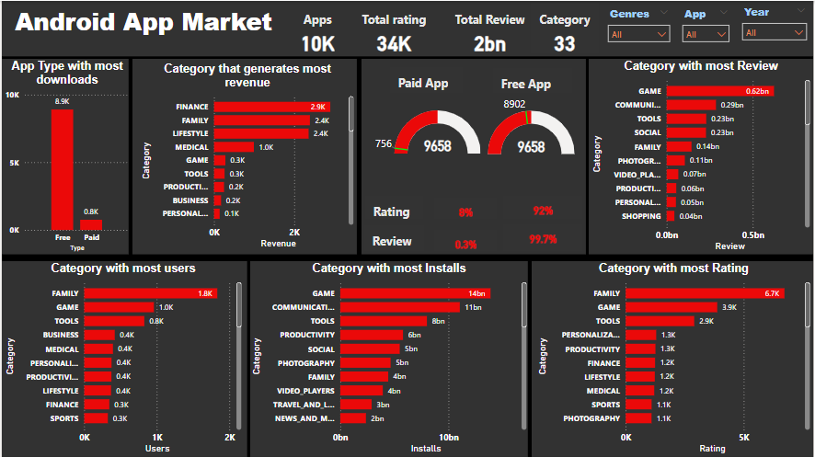
Data Over View

Slide 5
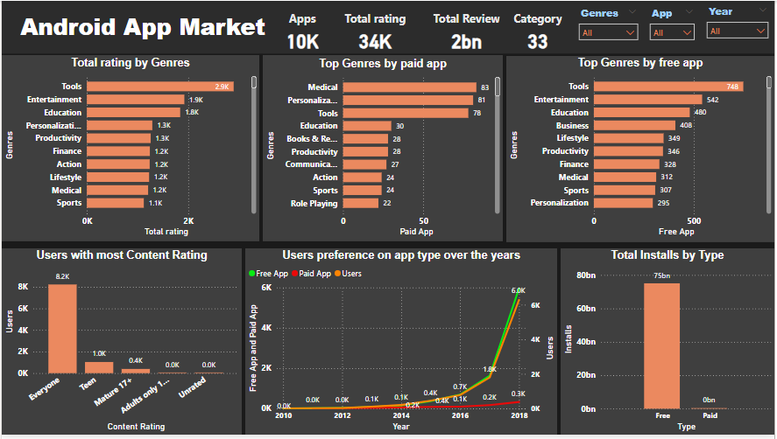

Slide 6
KEY METRICS
Apps: 10k
Total Rating : 34k
Total Review : 2bn
Category: 33

Slide 7
INSIGHTS
Analysis by Category
The android app has recorded 33 categories across its 10K apps and this has helped answer some questions.
Top 5 categories that generated most revenues are:
Finance:2.9k , Family: 2.4k, Lifestyle: 2.4k, Medical: 1k, Game: 283
Top 5 categories with most users are:
Family: 1.8k, Game: 1k, Tools: 827, Business: 420, Medical: 395
Top 5 categories with most Installs are:
Game: 14bn, Communication: 11bn, Tools 8bn, Productivity: 6bn, social: 5bn
Top 5 categories with most Rating are:
Family: 6.7k, Game: 3.9k, Tools: 2.9k, personalization: 1.3k, Productivity: 1.3k

Slide 8
INSIGHTS
Out of the 10k apps in the market, free app has a total of 8.9k apps and paid apps has 756 apps in the market.
Top 5 Rating by genre are:
Tools: 2.9k, Entertainment: 1.9k, Education: 1.8k, Personalization: 1.3k, Productivity: 1.3k
Top 5 Genre by paid app are:
Medical: 83, Personalization: 81, Tools: 78, Education: 30, Books & reference:28
Top 5 Genre by free app are:
Tools: 748, Entertainment: 542, Education: 480, Business: 408, Lifestyle: 349
The popularity of free apps has been steadily rising, reaching its peak in 2018 with the highest number of users. This trend highlights the growing demand for free apps and the potential for significant reach and impact in this market.

Slide 9
The free app has the highest number of installations, with a total of 75 billion installed apps, while the paid app only has 574 installations.
Users with most content rating are:
Everyone : 8.2k, Teen: 1.0k, Mature 17+ : 392.

Slide 10
SUMMARY
This analysis has provided key findings, insights into user preferences, app trends, and potential recommendations for business growth and improvement. The results obtained from this analysis highlight opportunities for increased profitability and user satisfaction.
Recommendation
Family Category is the user's top preference for apps, as everyone wants to have good times with family .
Tools and Entertainment also happens to be at the top of its genre, so more should be produced to improve market sales and maintain market value.

